Slide 1
Multithreading and File Handling in Java
Presented By: Mirazul Islam Java Instructor, EU

Slide 2
What is a Thread?
A thread is a lightweight subprocess.
It is the smallest unit of execution.
Threads run concurrently within a program.
Java supports multithreading natively.

Slide 3
Benefits of Multithreading
Improved application performance.
Efficient use of CPU resources.
Better user experience with responsive UI.
Useful for performing multiple tasks simultaneously.

Slide 4
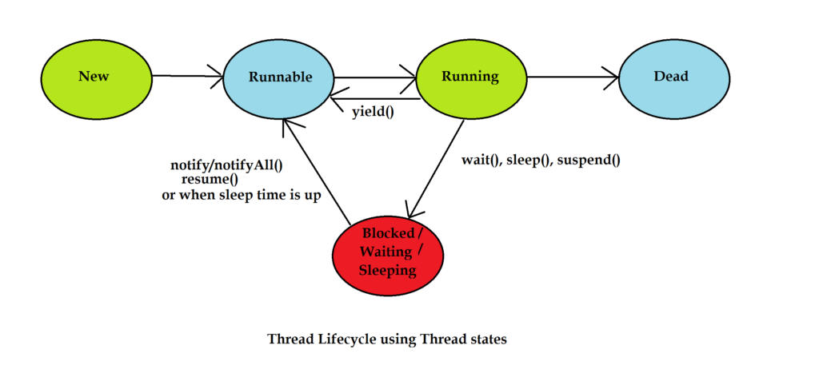
Java Thread Lifecycle
States:
New – Thread is created.
Runnable – Ready to run.
Running – Currently executing.
Blocked/Waiting – Waiting for resources.
Terminated – Execution finished.

Slide 5
Creating Threads in Java
Extending Thread class
class MyThread extends Thread {
public void run() {
System.out.println("Thread running");
}
}
Implementing Runnable interface
class MyRunnable implements Runnable {
public void run() {
System.out.println("Thread running");
}
}

Slide 6
Starting a Thread
MyThread t1 = new MyThread();
t1.start(); // Starts a new thread
// OR
Thread t2 = new Thread(new MyRunnable());
t2.start();

Slide 7
Thread Methods
start() – Starts the thread.
run() – Defines thread's code.
sleep(ms) – Pauses thread for milliseconds.
join() – Waits for thread to die.
isAlive() – Checks if thread is alive.

Slide 8
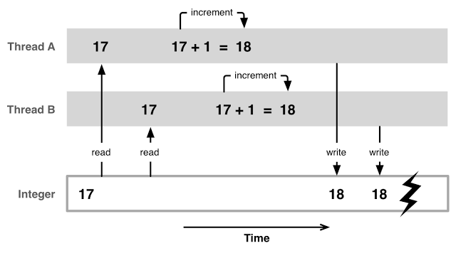
Synchronization
Prevents race conditions.
Ensures thread safety.
synchronized void myMethod() {
// thread-safe code
}

Slide 9
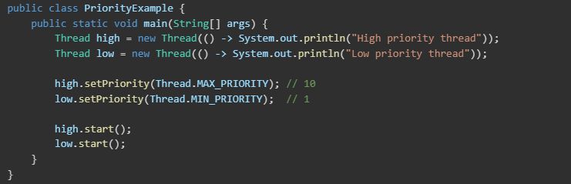
Thread Priorities
Values: MIN_PRIORITY, NORM_PRIORITY, MAX_PRIORITY
Constant | Value | Description
Thread.MIN_PRIORITY | 1 | Lowest priority
Thread.NORM_PRIORITY | 5 | Default priority for threads
Thread.MAX_PRIORITY | 10 | Highest priority

Slide 10
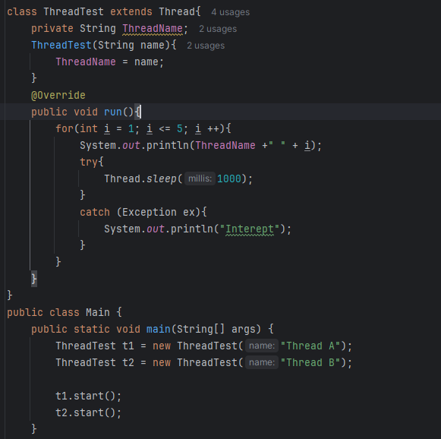

Slide 11
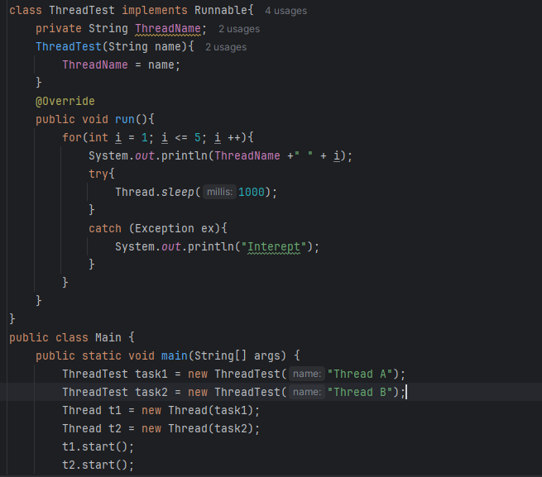

Slide 12
Real-Life Examples
Web servers handling multiple client requests.
Video games with separate threads for rendering, input, and audio.
Background data processing in mobile apps.

Slide 13
Introduction to File Handling
Java provides built-in classes for file handling.
Common file operations include reading, writing, and modifying files.
File handling in Java can be done using:
File class (for file properties and operations).
FileReader, FileWriter, BufferedReader, BufferedWriter.
NIO (New I/O) for advanced file handling.

Slide 14
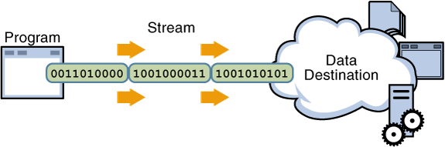
Streams
I/O Stream
Byte Stream
Character Stream
Byte Stream
Byte Stream
Byte Stream
Byte Stream

Slide 15
Java Methods Use in File Type
createNewFile() – Creates a new empty file.
exists() – Checks if the file exists.
delete() – Deletes a file.
renameTo(File dest) – Renames the file.
canRead(), canWrite() – Checks read/write permission.
length() – Returns the file size in bytes.
getName(), getPath() – Returns file name/path.
isFile(), isDirectory() – Checks file or directory type.

Slide 16
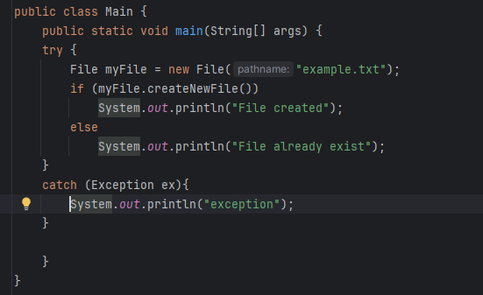
Create a File

Slide 17
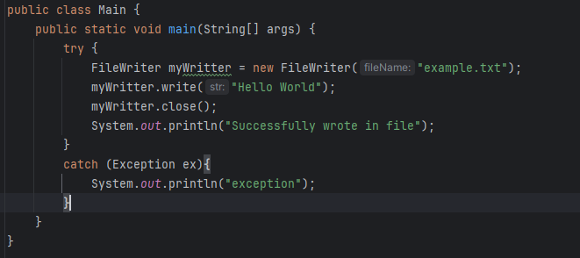
Java File Writer

Slide 18
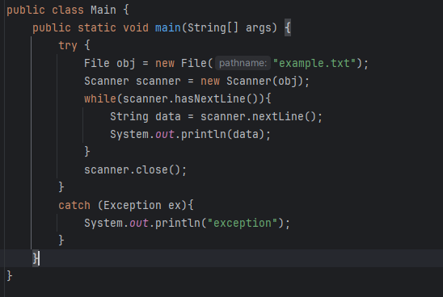
Java File Reader

